Slide 1
Superstore Data Analysis
Teresa Le

Slide 2
Goals and Methods
Goals
Analyze data and discover the following:
Most and least profitable regions
Most and least profitable category and subcategory of products
Most and least profitable customer segments
Derive insights regarding sales, cost of sales, and profitability
Provide recommendations based on the findings
Methods
Use a combination of MS Excel and Tableau to explore the dataset, visualize the data and derive insights

Slide 3
Information About Dataset
Dataset: Sample of Superstore dataset
Data collected from the years 2014 – 2017
Superstore sells goods to US customers only
All orders are shipped to customers which implies that Superstore is an online store

Slide 4
Transforming the Data
Added a Cost of Sales column – Took the difference between sales and profit
Added a Cost of Discount column – Multiplied sales by the discount %
Added a Year column – Took the year from the order date column (which was in mm/dd/yyyy format)

Slide 5
Findings – By Region

Slide 6
Profit by Region
Most profitable region: West
Least profitable region: East
Profit for West and East region increased from 2016 – 2017
Profit for South and Central region decreased from 2016 – 2017

Slide 7
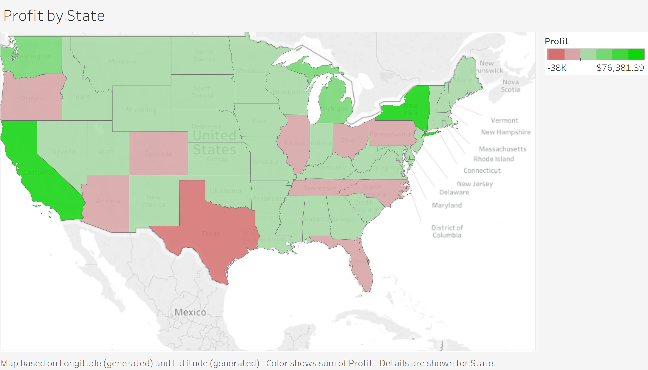
Profit by State
Most profitable states: California (#1) and New York (#2)
Least profitable states: Texas (#1) and Ohio (#2)

Slide 8
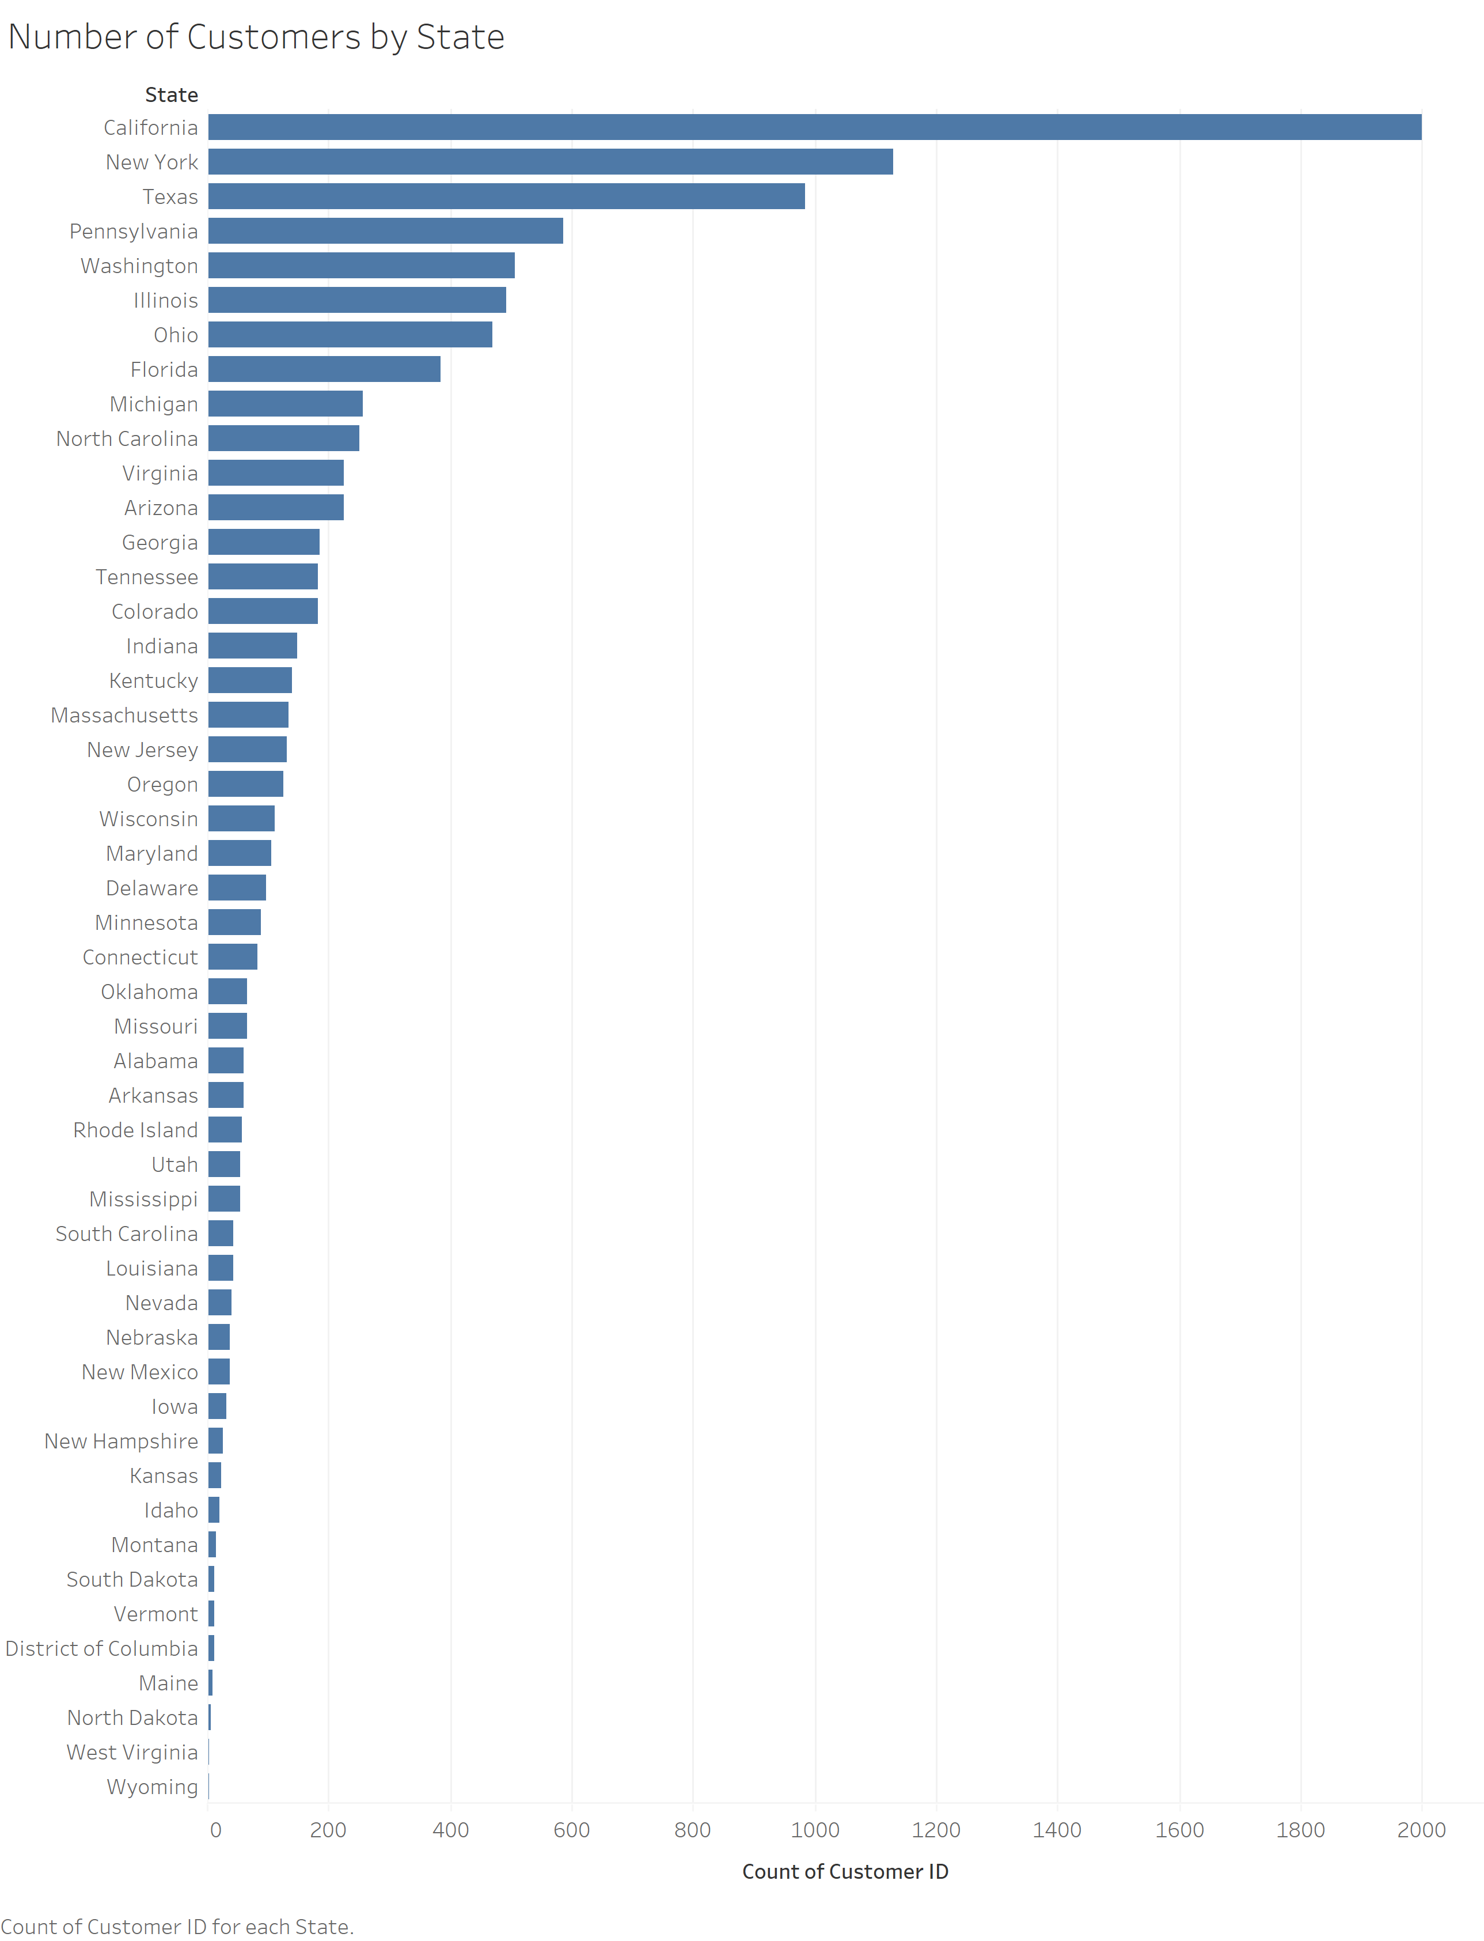
Number of Customers by State
A greater # of customers does not necessarily lead to more profit
Texas (top 3) and Ohio (top 10) are the least profitable states, but are in the top 3 and top 10 respectively when it comes to the # of customers

Slide 9
Findings – By Category and Subcategory

Slide 10
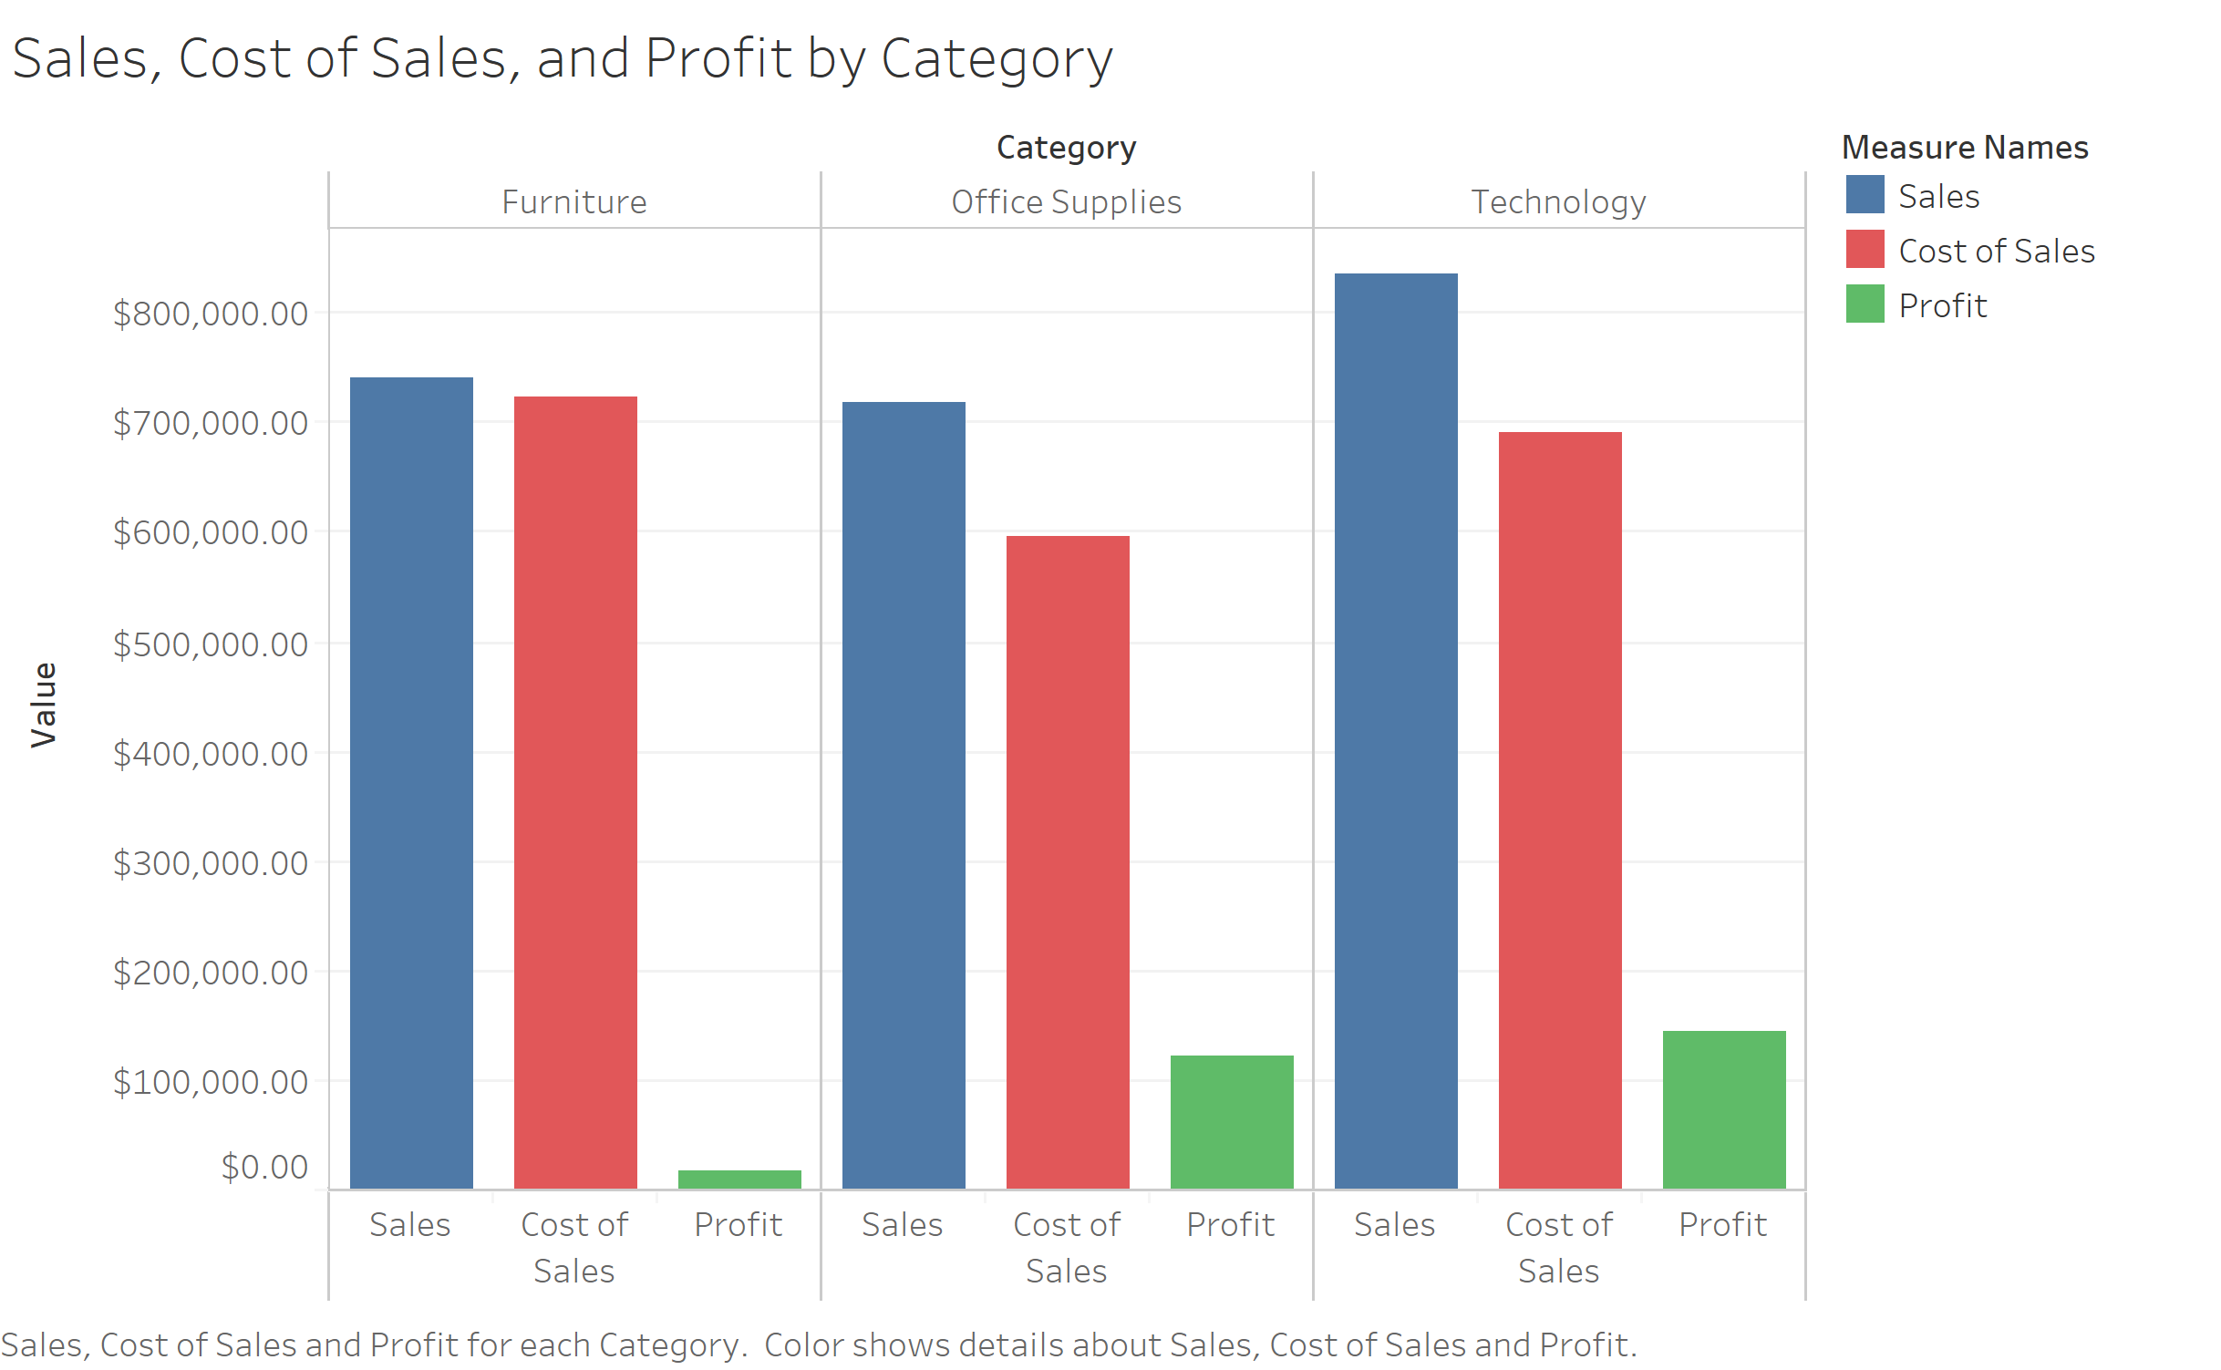
Sales, Cost of Sales, and Profit by Category
Technology product category #1 in terms of sales and profit
Furniture is last in terms of profit due to relatively high cost of sales
Category | Sum of Sales | Cost of Sales | Total Profit | Average Profit
Furniture | $ 741,999.80 | $ 723,548.52 | $ 18,451.27 | $ 8.70
Office Supplies | $ 719,047.03 | $ 596,556.23 | $122,490.80 | $ 20.33
Technology | $ 836,154.03 | $ 690,699.08 | $145,454.95 | $ 78.75
Grand Total | $ 2,297,200.86 | $ 2,010,803.84 | $286,397.02 | $ 28.66

Slide 11
Profit by Category and Year
Profit of Technology and Office Supplies has been increasing over the last 3 years
Profit of Furniture has been fluctuating over the last 3 years; forecasted to decrease in the future

Slide 12
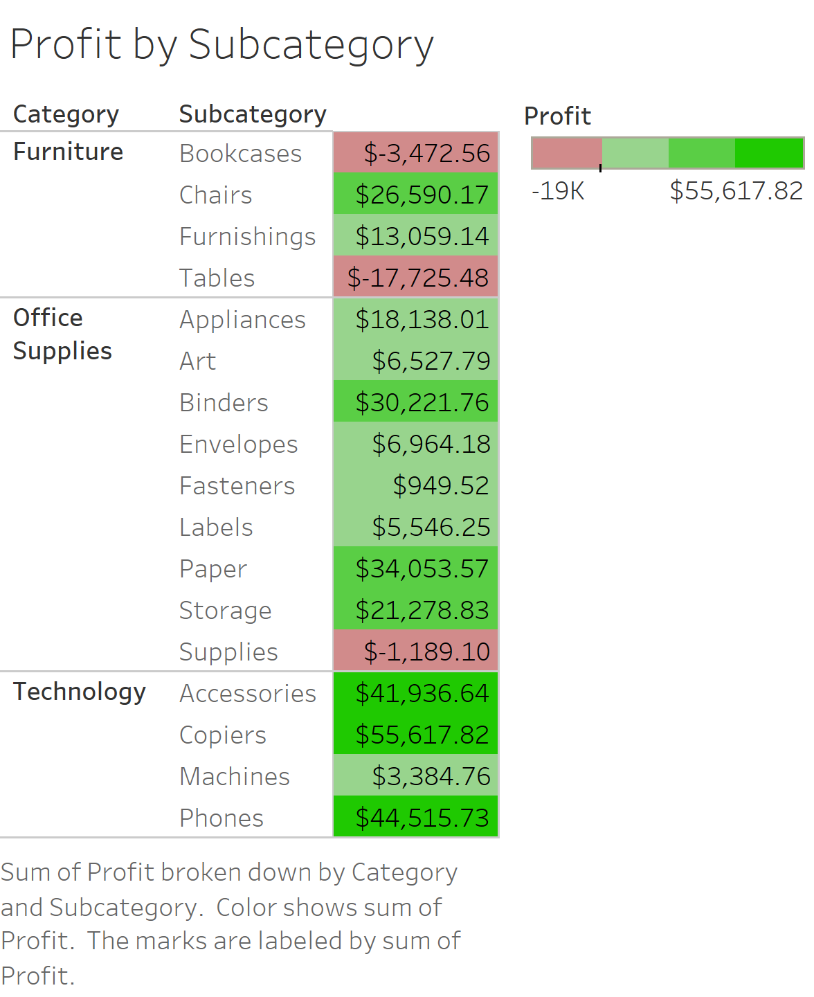
Profit by Subcategory
Most profitable subcategories: Copiers, Phones, and Accessories
Least profitable subcategories: Tables, Bookcases, and Supplies
Performance of subcategories such as Tables and Bookcases explain Furniture’s performance (shown in previous slide)

Slide 13
List of Products for Top 3 Worst Performing Subcategories
To view the complete table, click on the image

Slide 14
Findings – By Segment

Slide 15
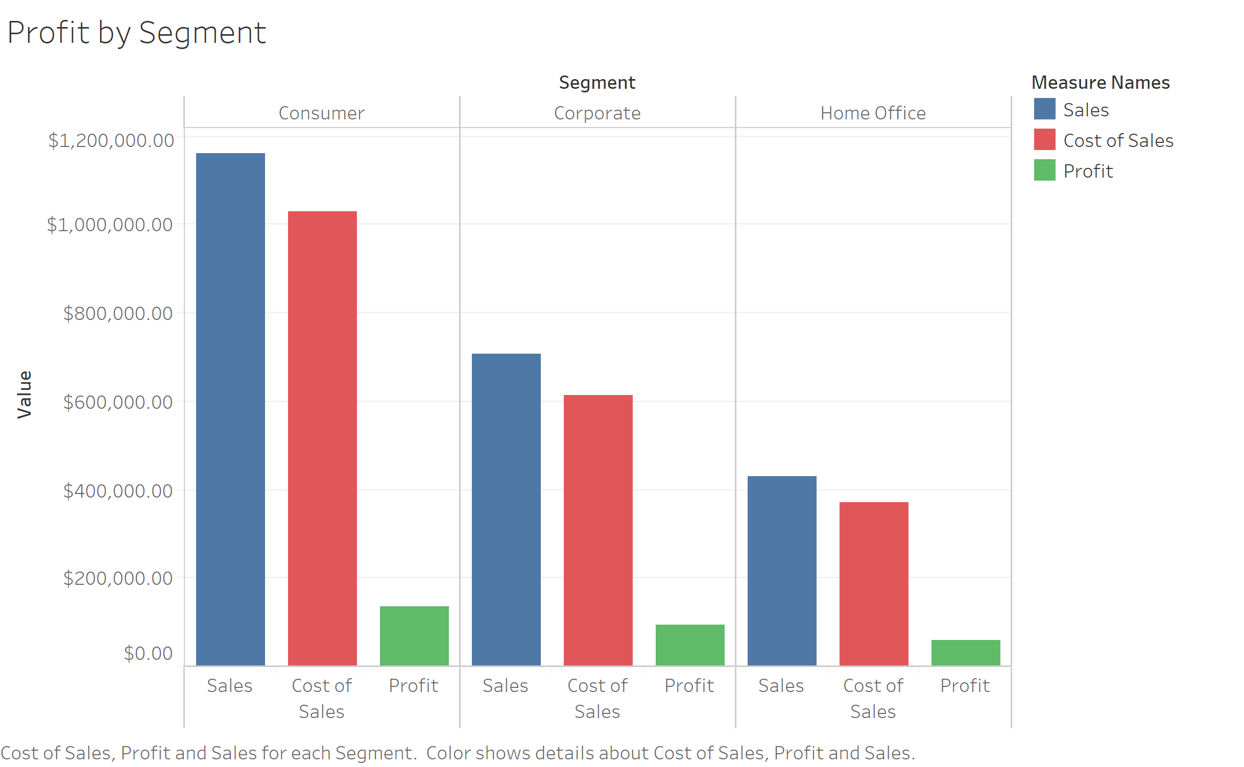
Profit by Segment
Most profitable segment: Consumer
Least profitable segment: Home Office

Slide 16
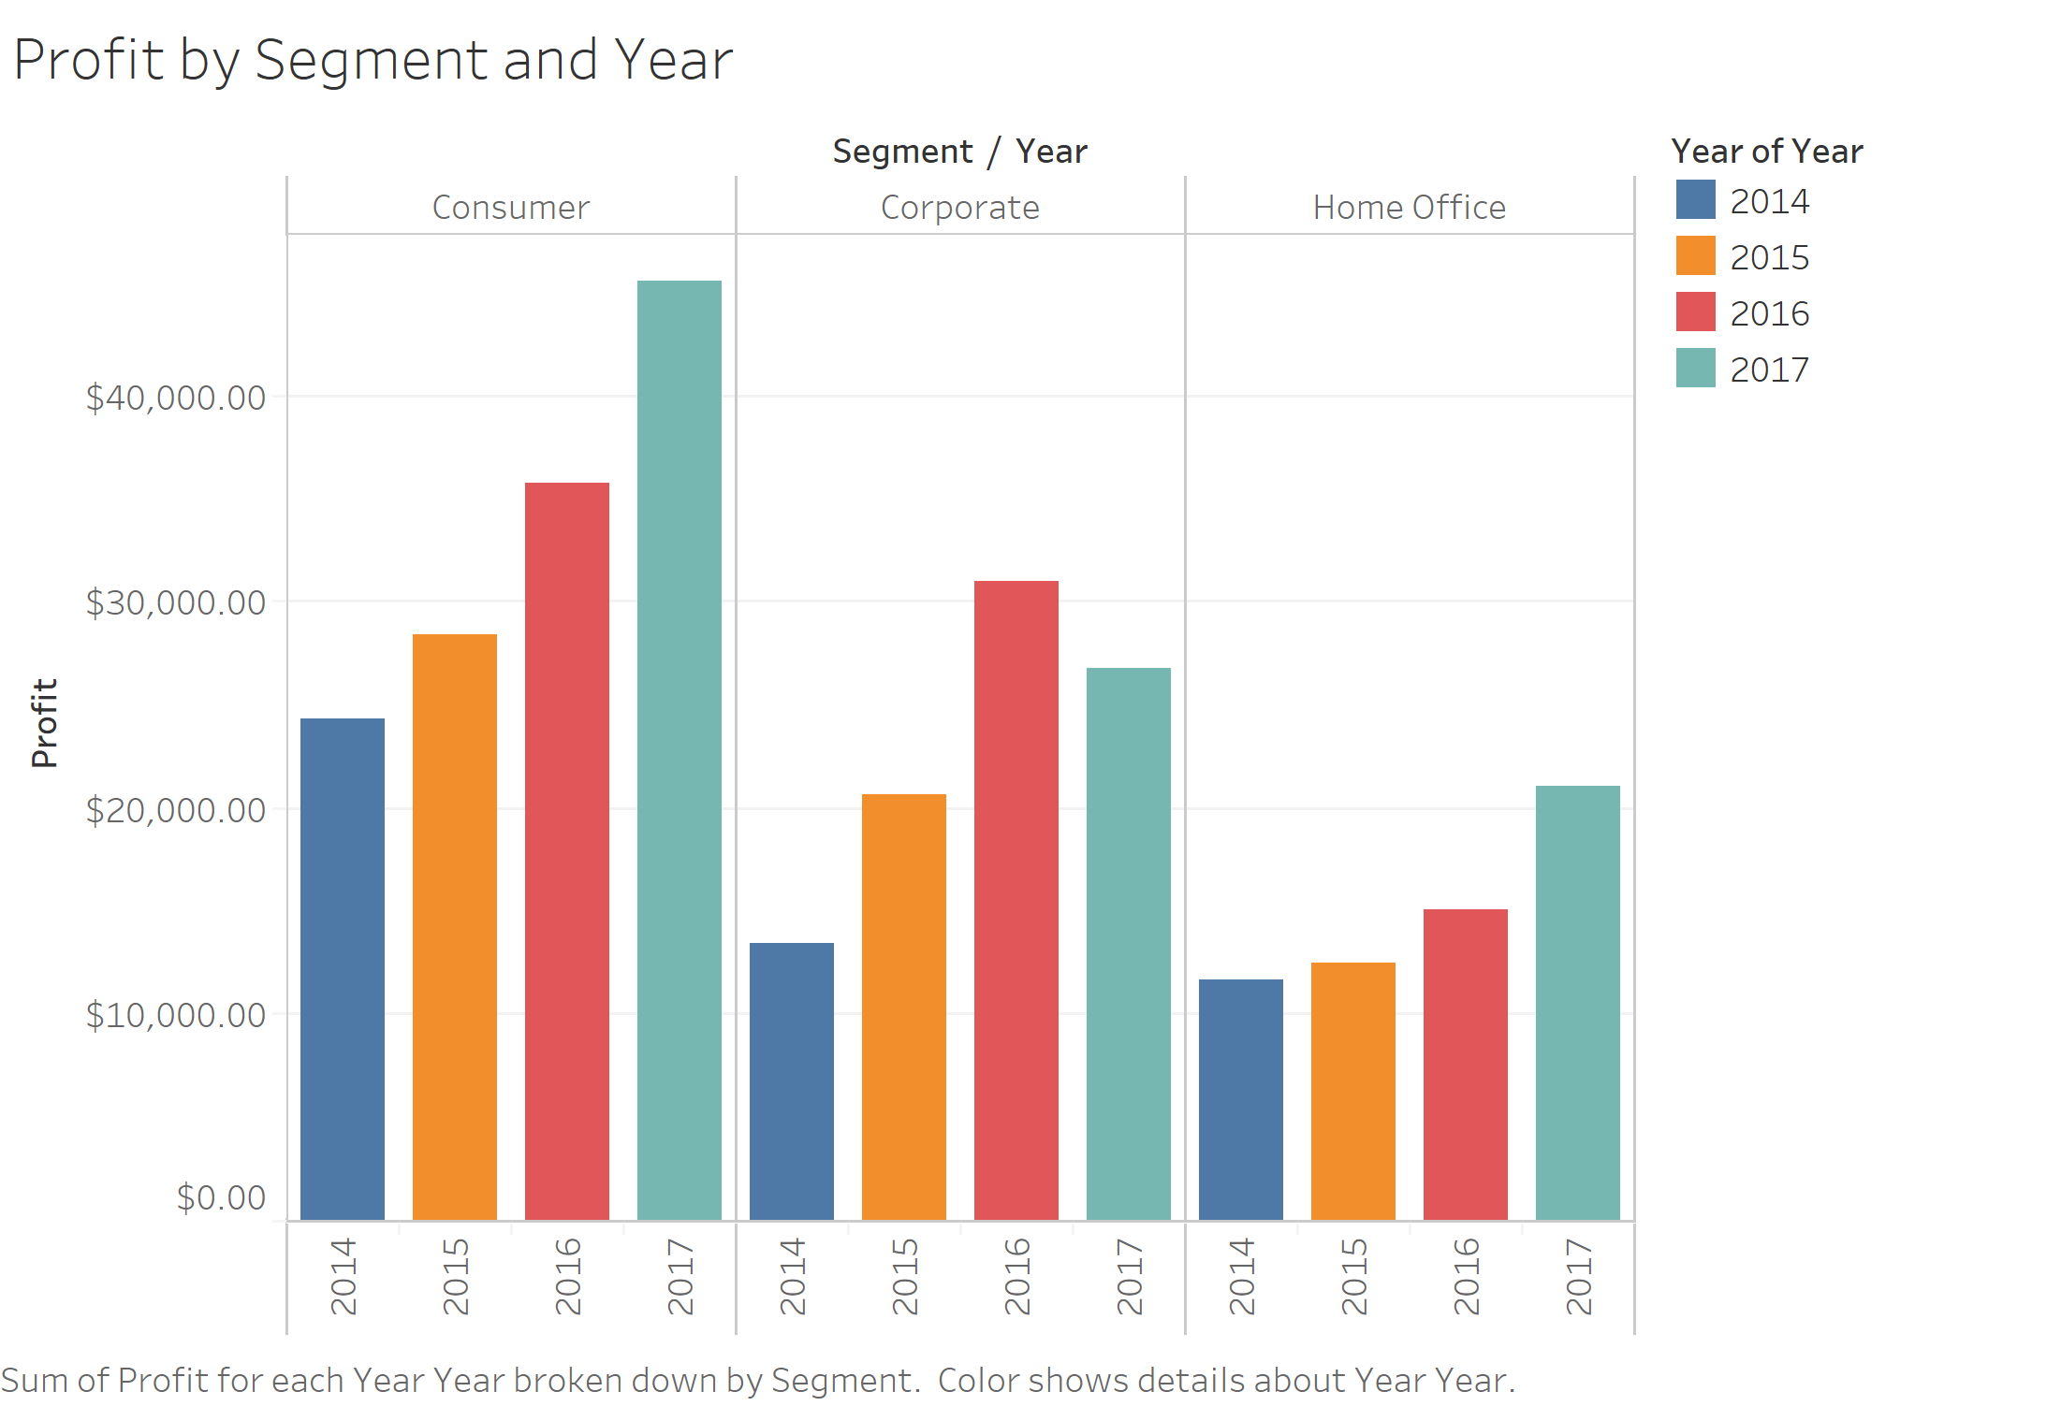
Profit by Segment and Year
Consumer segment has been the most profitable segment since 2014
Except for the Corporate segment, all segments have increased in terms of profit every single year
Profit for Corporate segment decreased from 2016-2017

Slide 17
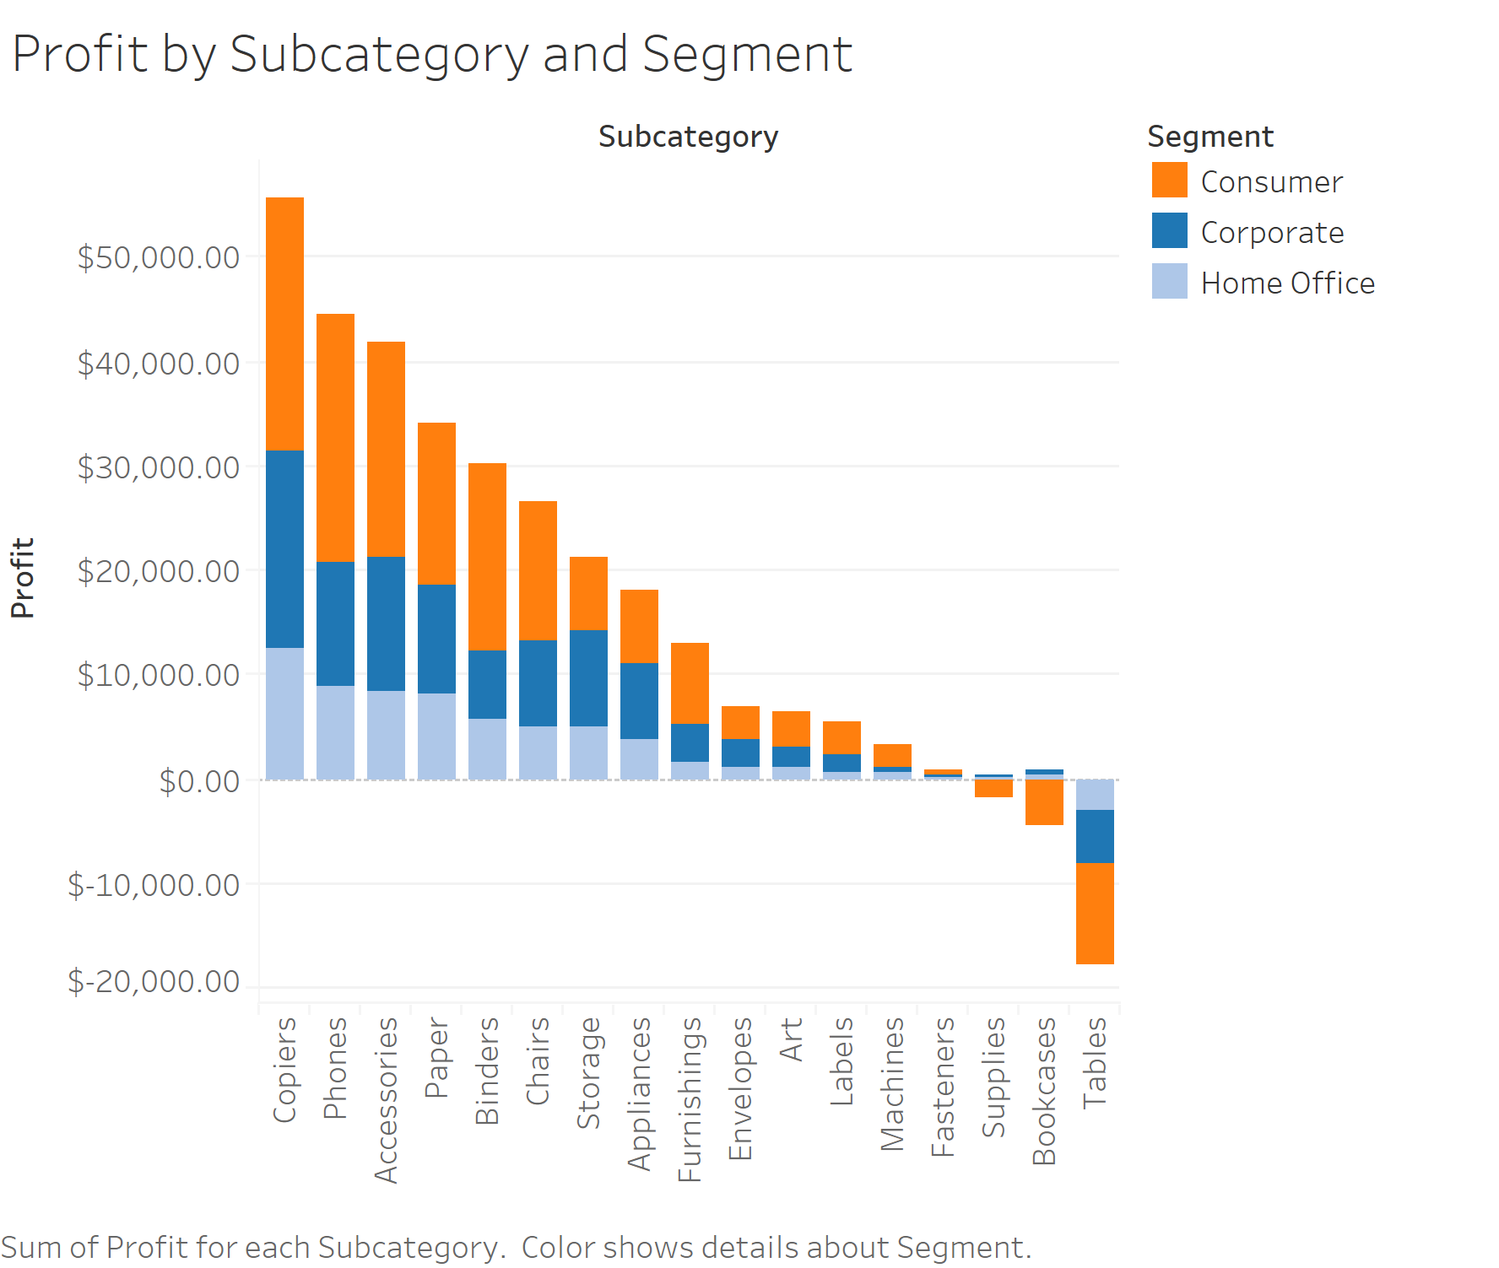
Profit by Subcategory and Segment
Tables are not profitable across all segments
Bookcases and supplies are not profitable due to the purchases made by the consumer segment

Slide 18
Profit and Cost of Discount by State and Segment
To view the full chart, click on the image

Slide 19
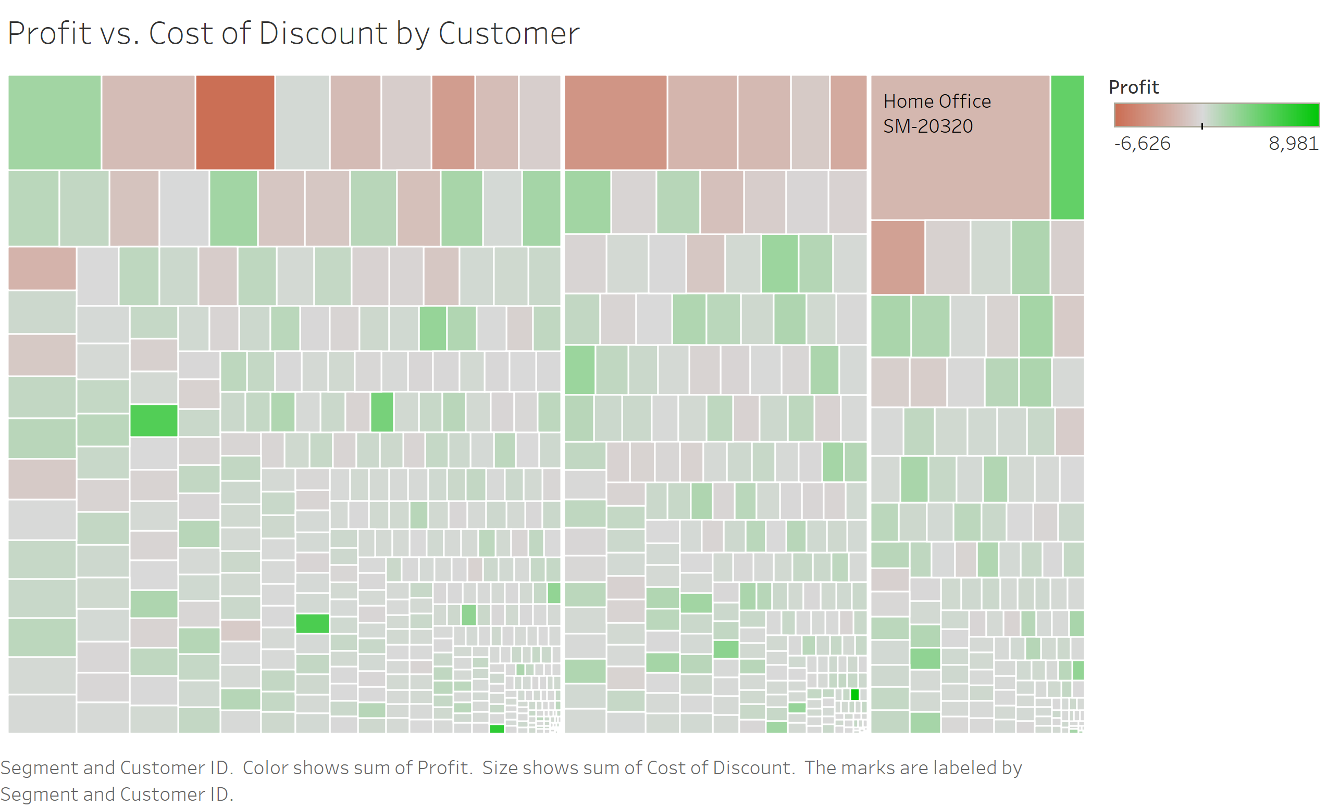
Profit and Cost of Discount by Customer
Some of the largest discounts were given to the least profitable customers (shown by the larger and more red rectangles)

Slide 20
Recommendations

Slide 21
Recommendations – Next Steps
Finding
Superstore offered discounts on products that were so large that they ended up making less than $0 in profit on those products
Recommendation
Limit discounts so that they’re only applicable to certain (profitable) products e.g. provide a discount code that can only be applied to certain tables
If sales of products that have been historically unprofitable lag due to the lack of discount, Superstore may also want to consider discontinuing those products
Further investigation can be done by conducting a market basket analysis to fully understand the impact of discontinuing certain products

Slide 22
Recommendations – Next Steps
Finding
Discounts were provided to unprofitable customers
Recommendation
Provide discounts based on profitability to incentivize highly profitable customers to purchase more
Recommended technology for implementation: Customer relationship management software and email marketing software
Finding
Superstore does not have very many customers (<100) from certain states
Recommendation
Conduct market research and increase advertising in regions that have high opportunities for growth

